Slide 1




NEW
WARE
Nihad Maharramov (INHA IT-3)
01

Slide 2
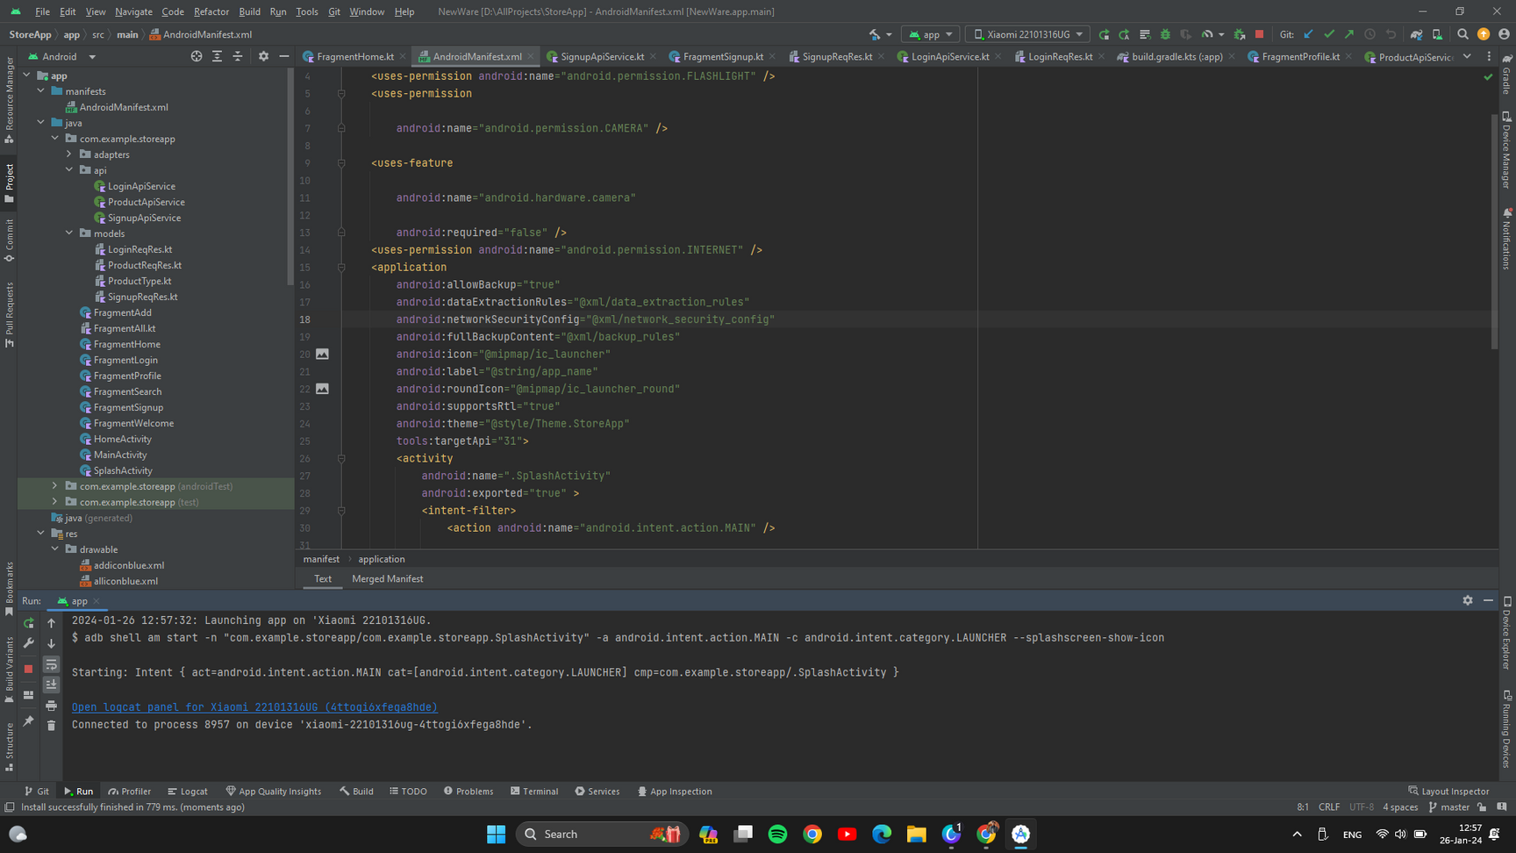
WORKS
Project works correctly

Slide 3
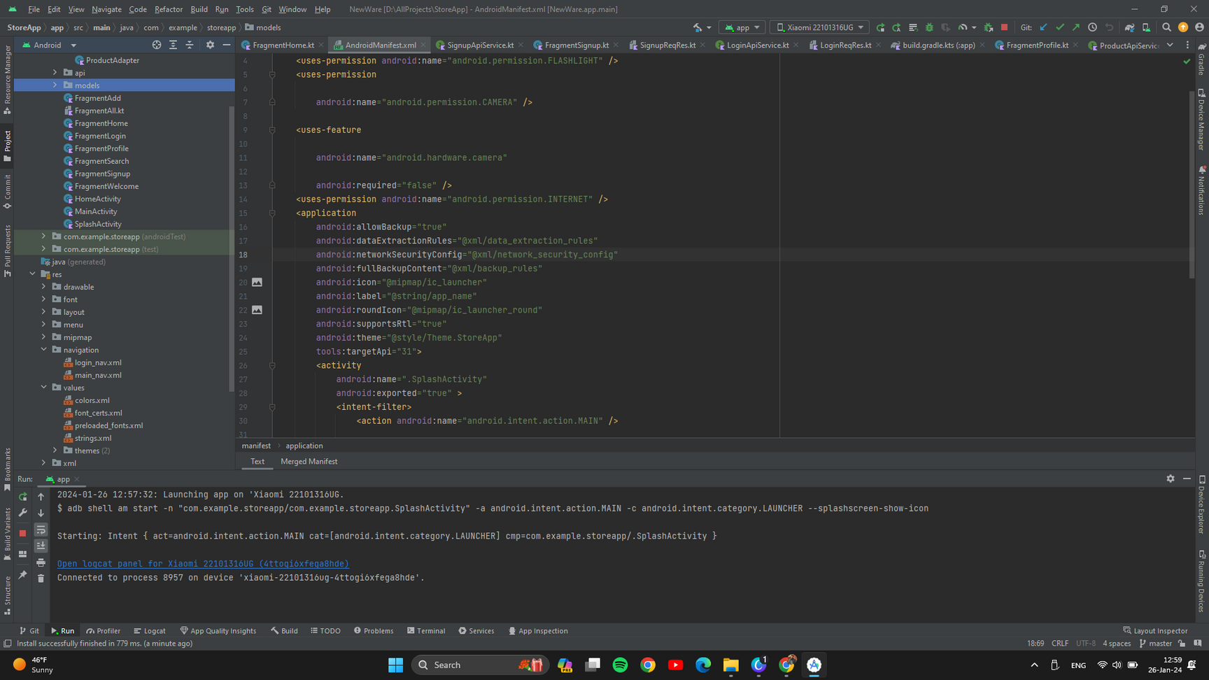
2. CLEAN STRUCTURE

Slide 4

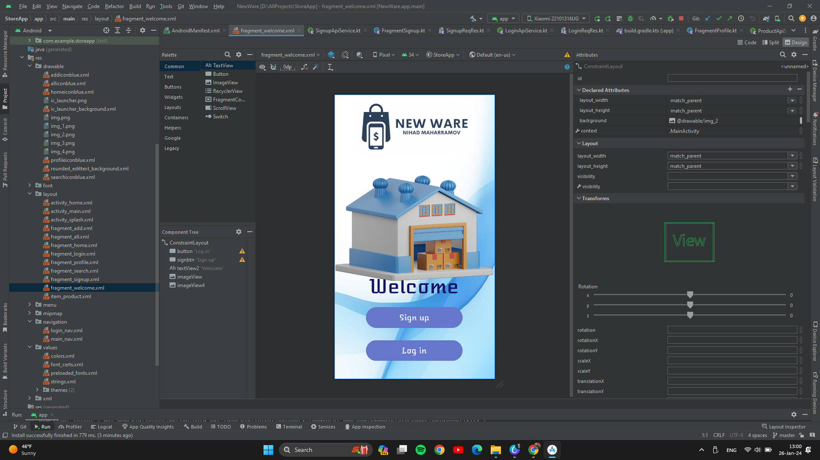
3. DESIGN

Slide 5
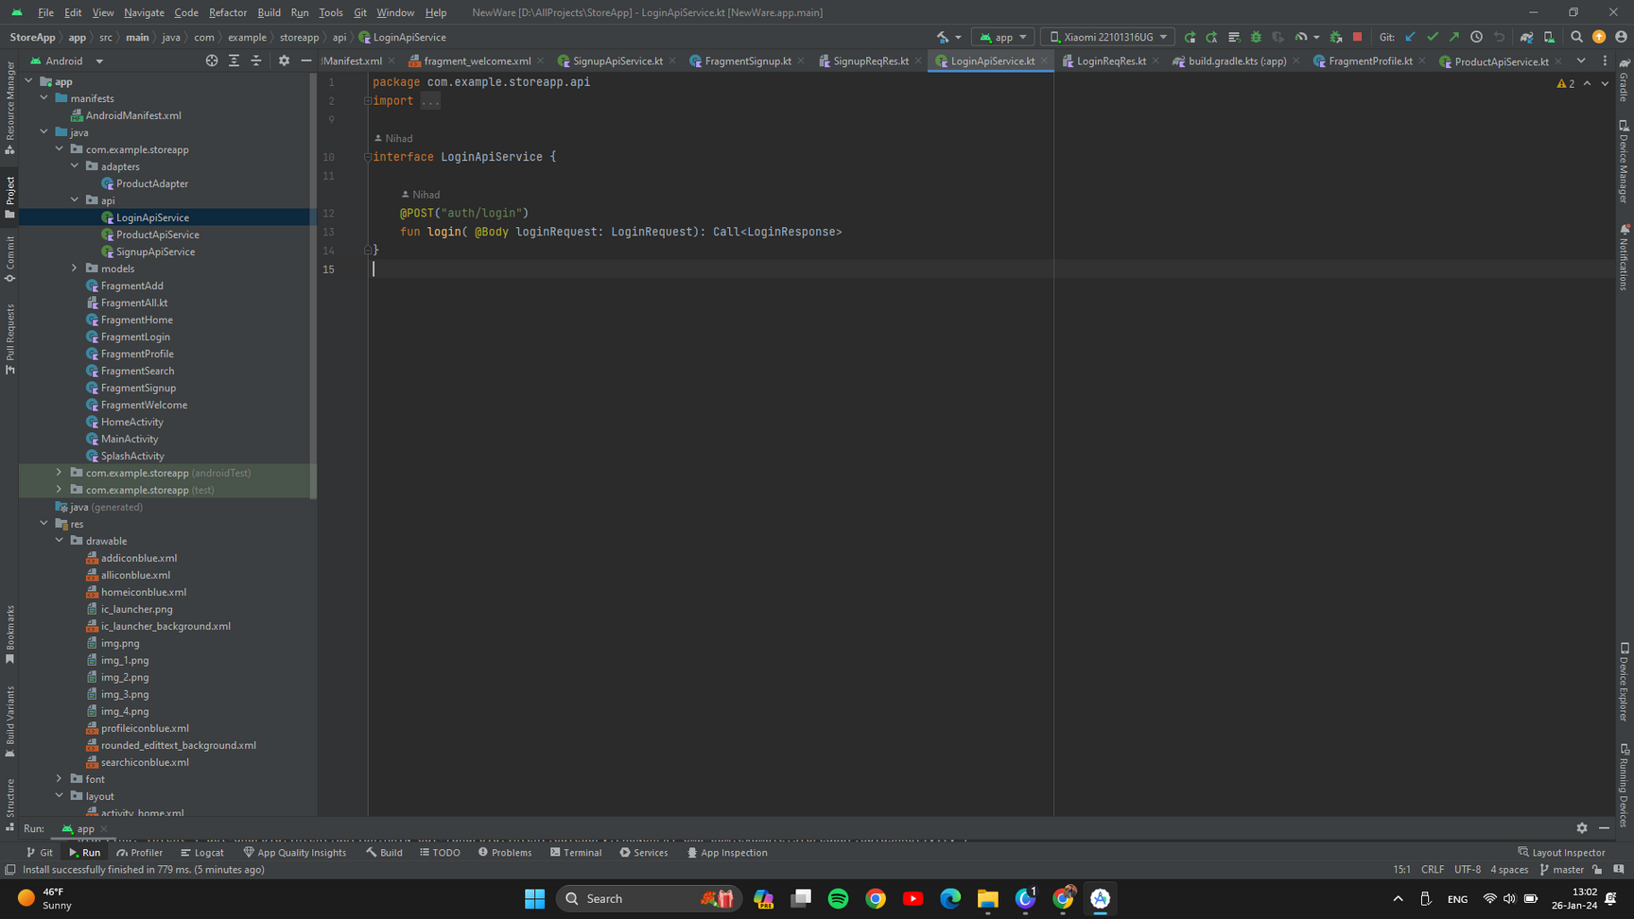
4.USING API

Slide 6
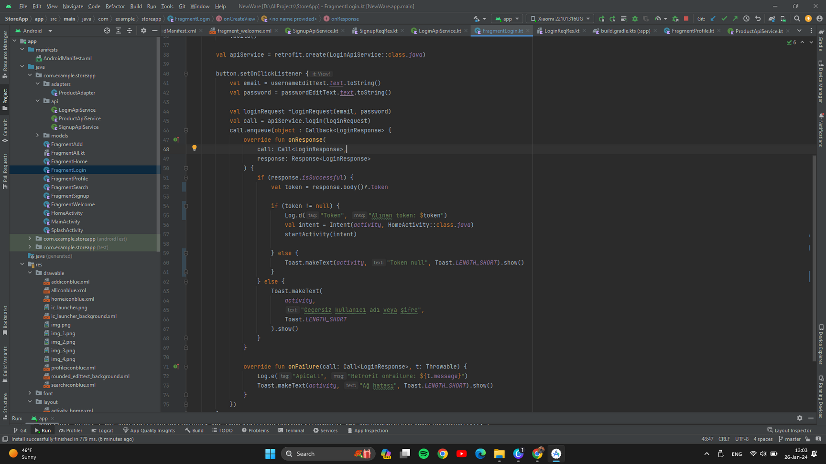
5. Login/Signup

Slide 7
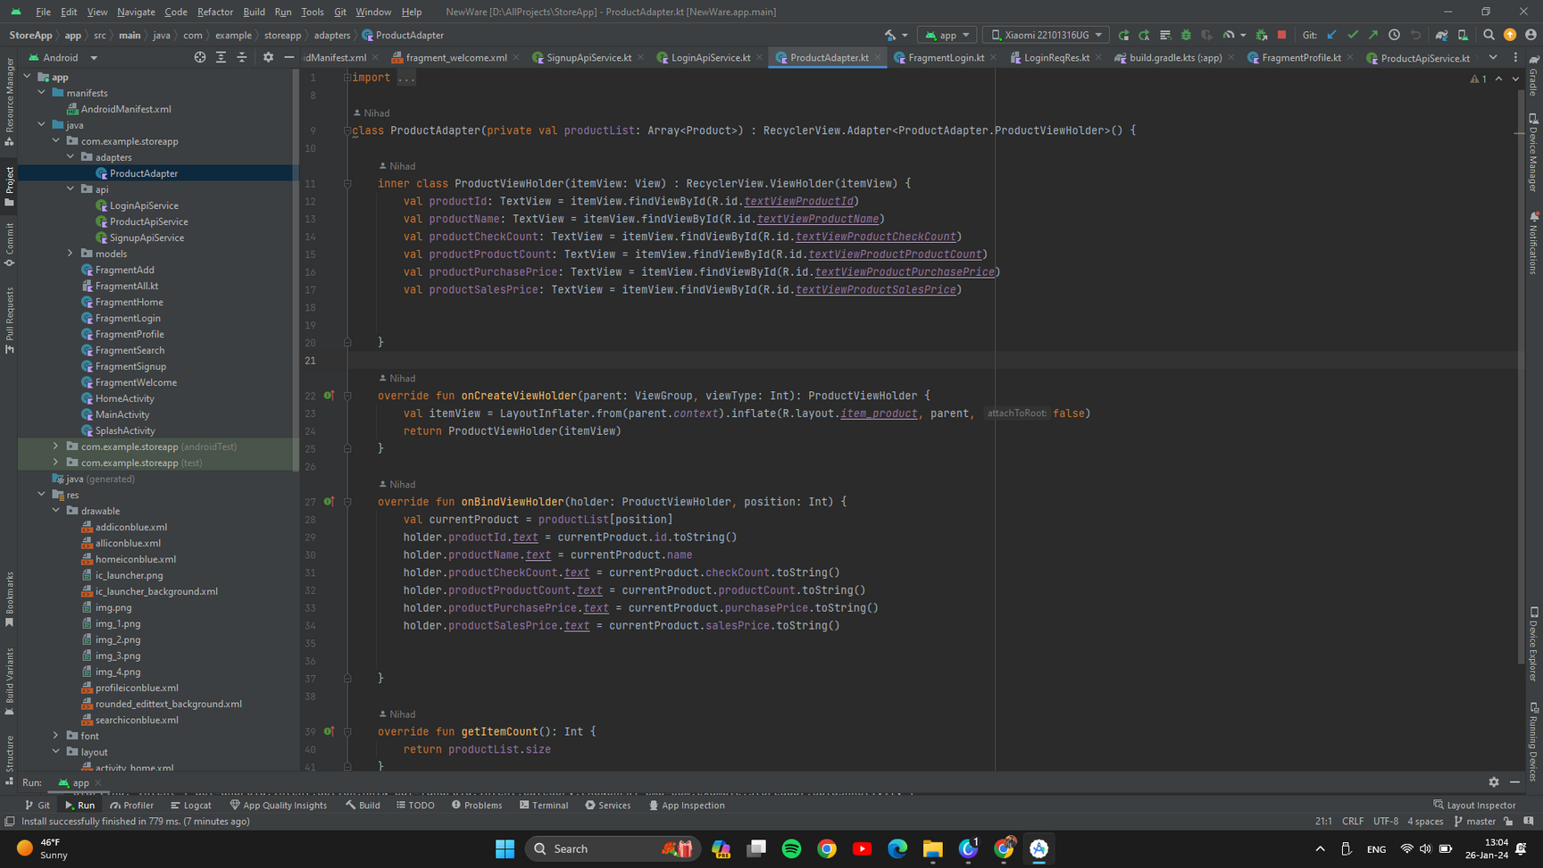
6. USING OOP

Slide 8
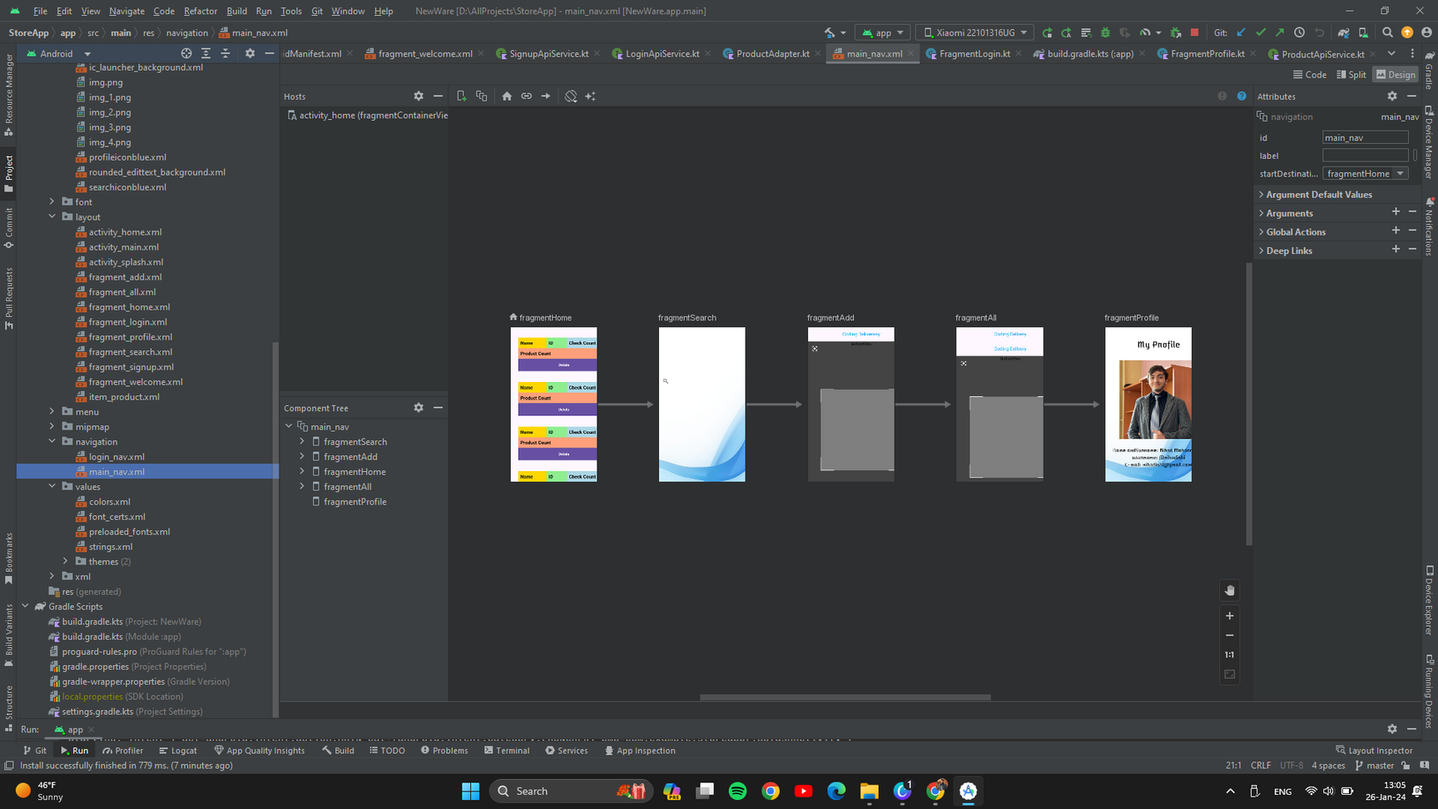
7. USING INTENTS

Slide 9
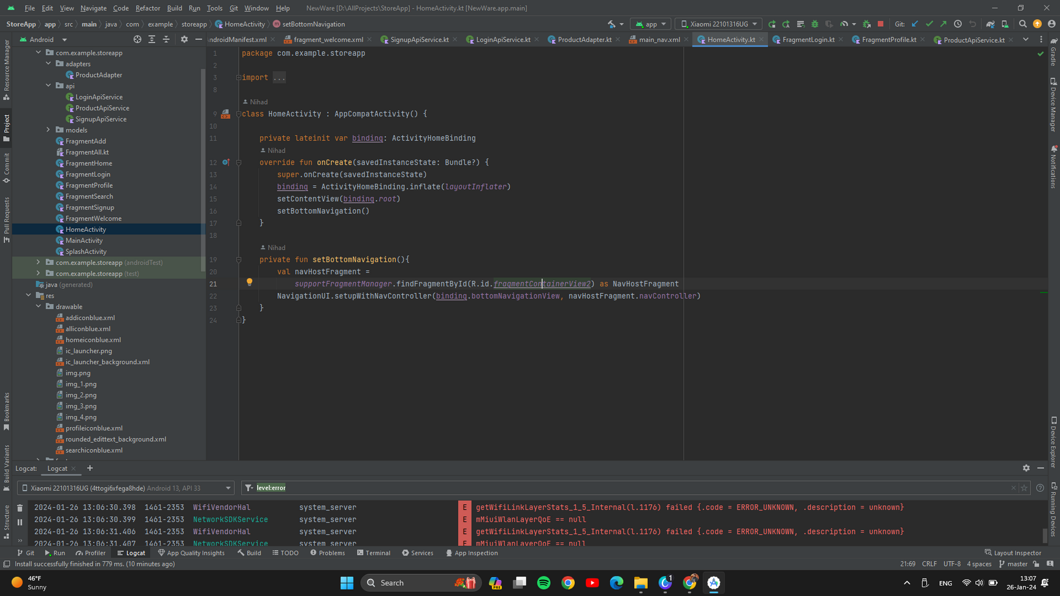
9. RUN APP

Slide 10
10. CUSTOM LOGO

Slide 11
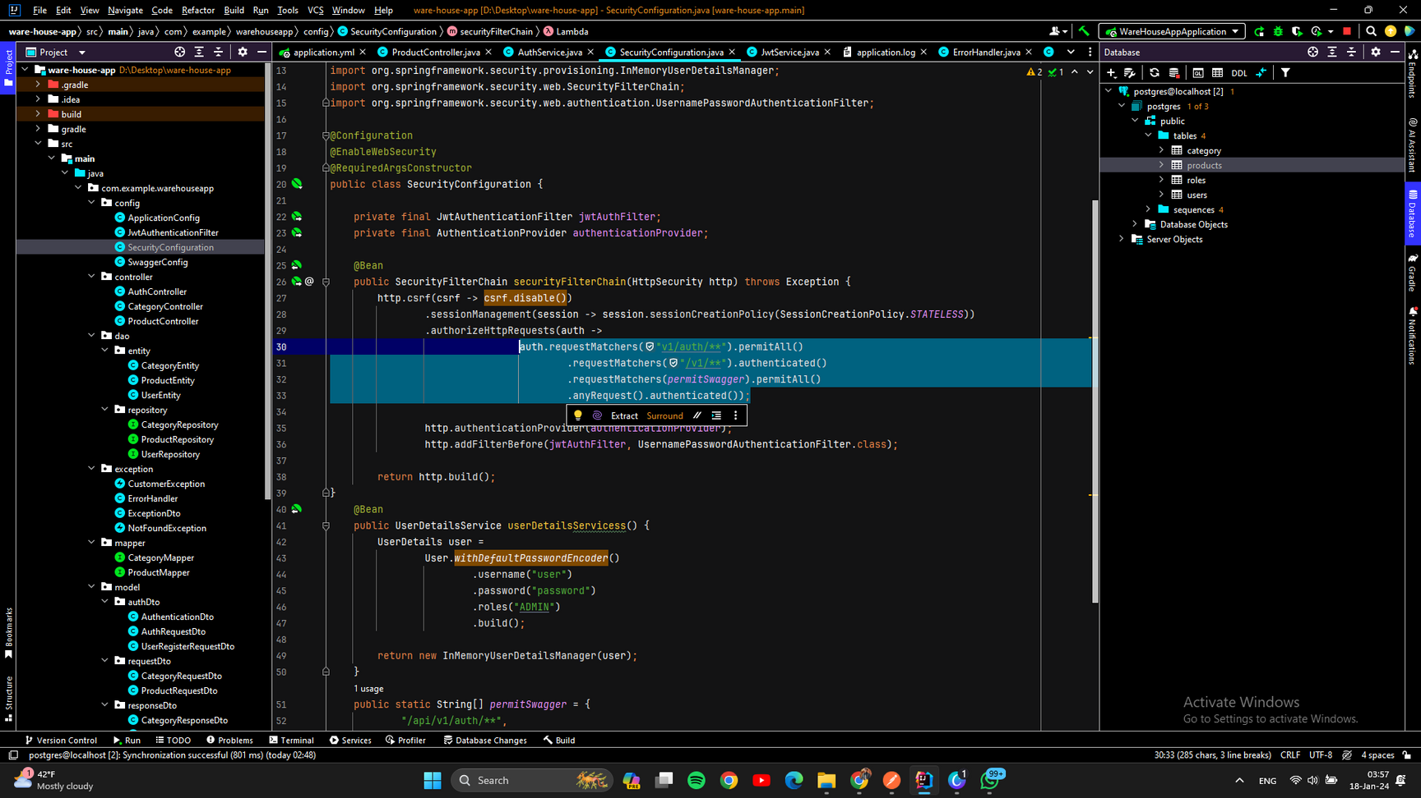
11. DATABASE

Slide 12

12. PRESENTATION

Slide 13
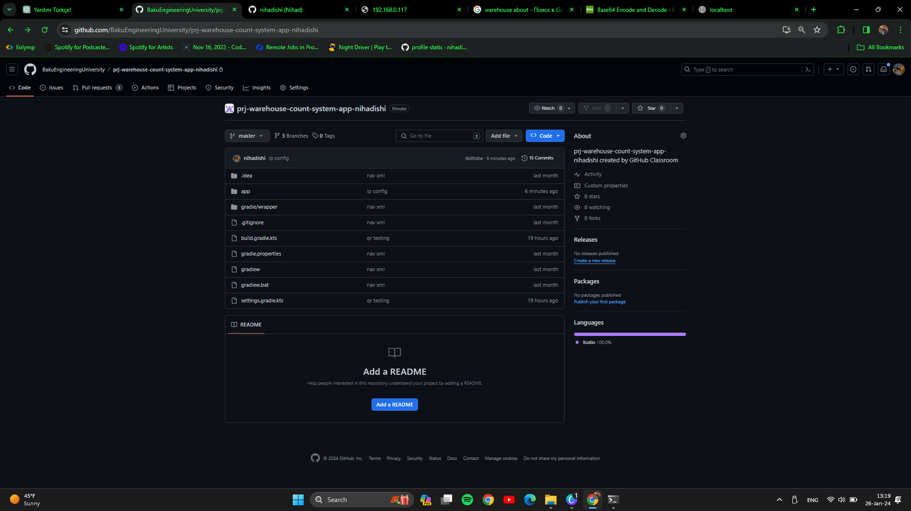
13. GIT COMMITS

Slide 14
PHONE
I'm ready to work with you!
077-637-38-38
EMAIL
nmeherremov1@std.beu.edu.az
Thank you!
WEBSITE
www.nihadishi.vercel.app

